Slide 1
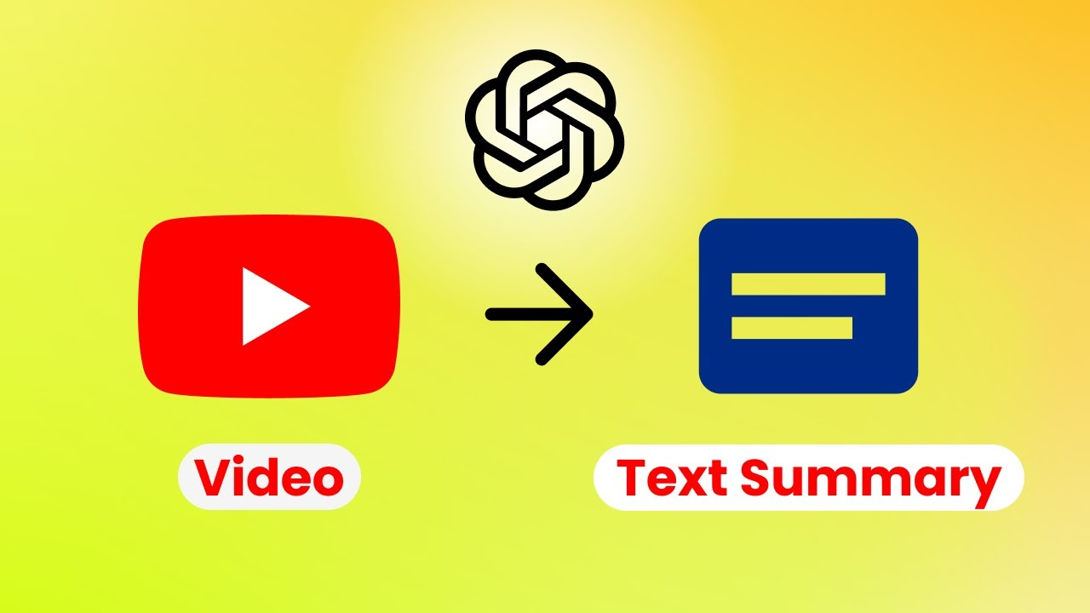
A PRESENTATION ON PRODUCT PLAN FOR YOUTUBE SUMMARIZER/TRANSCRIBE BY: STEPHEN MFON
Introduction:
YouTube Summarizer and Transcript is a built-in and browser extension tool design to enable users to efficiently access video contents and information on Youtube platform while enhancing learning, research, and productivity.

Slide 2
MARKET ANALYSIS/MARKET SIZE/SEGMENTATION
Market Analysis:
Target Audience:
Student especially with limited fund
Researcher requiring in-depth video content analyses
Anyone who consumes educational or informative videos on YouTube and Viewers with auditory processing difficulties or language barriers/impairment.
Segmentation:
1. Speaker: Speech recognition models to identify different voices based on who is speaking as well as when a new speaker is detected to help capture different viewpoints in a video.
2. Topic: To identifies keywords and phrases that indicate a shift in topic based on the main topics being discussed. The summary might present key points or arguments for each identified topic, creating a segmented overview using Natural Language Processing (NLP) techniques to analyse the transcript or audio content.
Market Size:
The global online video market is projected to reach an estimated value $853 billion by 2027, while YouTube boasts over 2 billion monthly users, highlighting a vast potential user base.

Slide 3
COMPETITIVE ANALYSES AND VALUE PROPOSITION
Introduction:
One identified competitor is Notta. Notta is an Artificial intelligent (AI) transcription tool designed to convert audio and video recordings into readable text transcripts with ease and accuracy.
NOTTA VS YOUTUBESUMMARIZER/TRANSCRIBE
Features | NOTTA | Youtube Sum./Trans.
1. Strength: | Notta is AI application, there is tendency for high accuracy . | Accuracy is believed to vary, especially with complex content. It free access increases number of users.
2. Weakness: | Users are expected to pay for subscription and can be expensive for some users. | Since it is free, its function will be limited.
3: Market Position | Target users include business professionals, researchers, journalists | Target users include students, professionals, researchers and other users.
Value Proposition:
The tool shall offer a compelling value to it users by increasing productivity, improve learning while saving time to enhance efficiency.

Slide 4

MARKETING STRATEGY/ CONCLUSION
MarketingStrategy:
A team of experts in IT fields will be employed to develop methodologies to ensure continuous product improvement based on user feedback and market trends while leveraging on targeted partnerships, content marketing on blogs, and strategic advertising to increase awareness of the tool.
Conclusion:
The YouTube Summarizer and Transcript is peep to grow as a cloud-based application while leveraging on AI technology to generate concise summaries and full transcripts of video content allowing for detailed reference.

